Slide 1

Meet the Teacher Evening
Wednesday 17th September 2025
6pm - 6.40pm - In the Hall
6.45pm - 7.10pm - session 1
7.15pm - 7.45pm - session 2

Slide 2

2024 – 2025
Achievements
New approach to Guided Reading and Spelling
Policies and curriculum documents were updated
Subject leaders observed lessons
RE curriculum was rewritten
Book scrutiny staff meetings

Slide 3
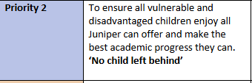
2024 – 2025 Achievements
We achieved an Area of Excellence for Inclusion in our January 2025 Challenge Partners QAR.
We continue to provide an exciting range of opportunities including sporting events, Energize, Reading at WHS, Forest School, Butterfly Curriculum etc.
Key staff have received training on trauma and attachment.
We have a new Relational Policy, Behaviour Policy and Governing Body Behaviour Written Principles that attachment aware, trauma informed.

Slide 4

2024 – 2025 Achievements
Our Year 6 children shared, using Jot Thoughts, what they think about Kagan Structures and how it helps them, their comments included;
"You get more confident speaking."
"You work with people you don’t normally work with."
"It makes learning fun. You learn to listen to others."
"Everyone can say something."
"You can make people better."
"It helps us to explain our answers."
"It helps me think more."
"It makes people feel valued."
"Everyone gets heard."

Slide 5

2024 – 2025 Achievements
CPD including whole school PACE training, Disadvantaged Challenge INSET day (Clive Lawrence), a number of staff have completed training courses eg Attachment Awareness and DDP (Dyadic Developmental Psychotherapy)
Part of the Virtual School AATI programme

Slide 6

2024 – 2025 Achievements
Year 4 visited Sands Bank (November and July).
Staff training on our rare butterflies.
Year 6 visited Duke of Burgundy conservation site.
Environment Minister led an assembly on our planting plan for our rare butterflies’ food.
Planters have been built around the school and filled with the plants our rare butterflies like to eat.

Slide 7
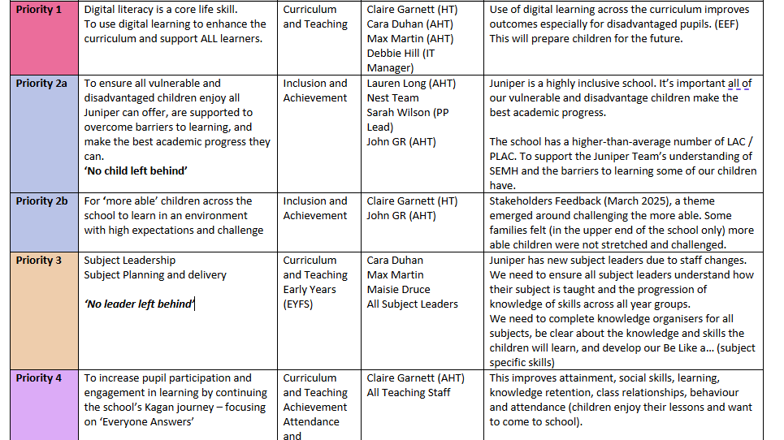
2025 – 2026 SDP (School Development Plan)

Slide 8
Where do the priorities in the SDP come from?
School's Reflections
Educational Research
Stakeholders Feedback
Challenge Partners QAR (Quality Assurance Review)
Visits to other schools
School Improvement Visits / Audits
Ofsted / Government Policy

Slide 9

Priority 1 – Digital Learning “The question is no longer whether technology should have a place in the classroom, but how technology can most effectively be integrated” EEF
1.1
The school is clear about which platform we will use. The school has produced, with support from the
governors, an analysis of the costs, alongside the teaching and learning benefits.
1.2
To bring the curriculum to life using virtual and augmented reality experiences.
1.3
To school is clear about the computing skills taught, in which half-term, by which year group, across the school. Identify opportunities to teach the different skills in other curriculum areas.
1.4
To provide a clear CPD action plan to implement the digit learning strategy. This will be a separate document.
1.5
To develop a separate action plan for AI.
1.6
To ensure the children at Juniper have a progress, informative Online Safety Curriculum that is responsive to
changes in the digital world.

Slide 10
Priority 2a – Vulnerable & Disadvantaged
'No child left behind'
2a.1 The curriculum is rich in extra opportunities for our most vulnerable children.
2a.2 The school demonstrates exceptional standards of inclusion; the most vulnerable children make outstanding progress in all areas.
2a.3 The most vulnerable children have a voice in the school and feel empowered to share their views about school life.

Slide 11
Priority 2b – More Able
'No child left behind'
To create a more able policy that includes how we define and identify the more able, and how we stretch and challenge the more able at Juniper. This will link to our Teaching and Learning Policy and our work on the Rosenshine Principles of Instruction.

Slide 12
Priority 3 – Curriculum
3.1 To ensure all subject leaders are experts in their subject, including the knowledge taught in each year group, the end points, where online safety, safeguarding and British Values are taught. For subject leaders to ensure this information is shared with ALL teachers across the school, including EYFS.
3.2 For each year group / subject leader to create knowledge organisers for each subject. To develop our Be Like a… (subject specific) skills in all year groups. The children will be able to articulate the skills of a musician, writer etc. For year groups to share more information about the curriculum with our Juniper families, this was an area for us to address following the stakeholder’s questionnaire (March 2025)

Slide 13
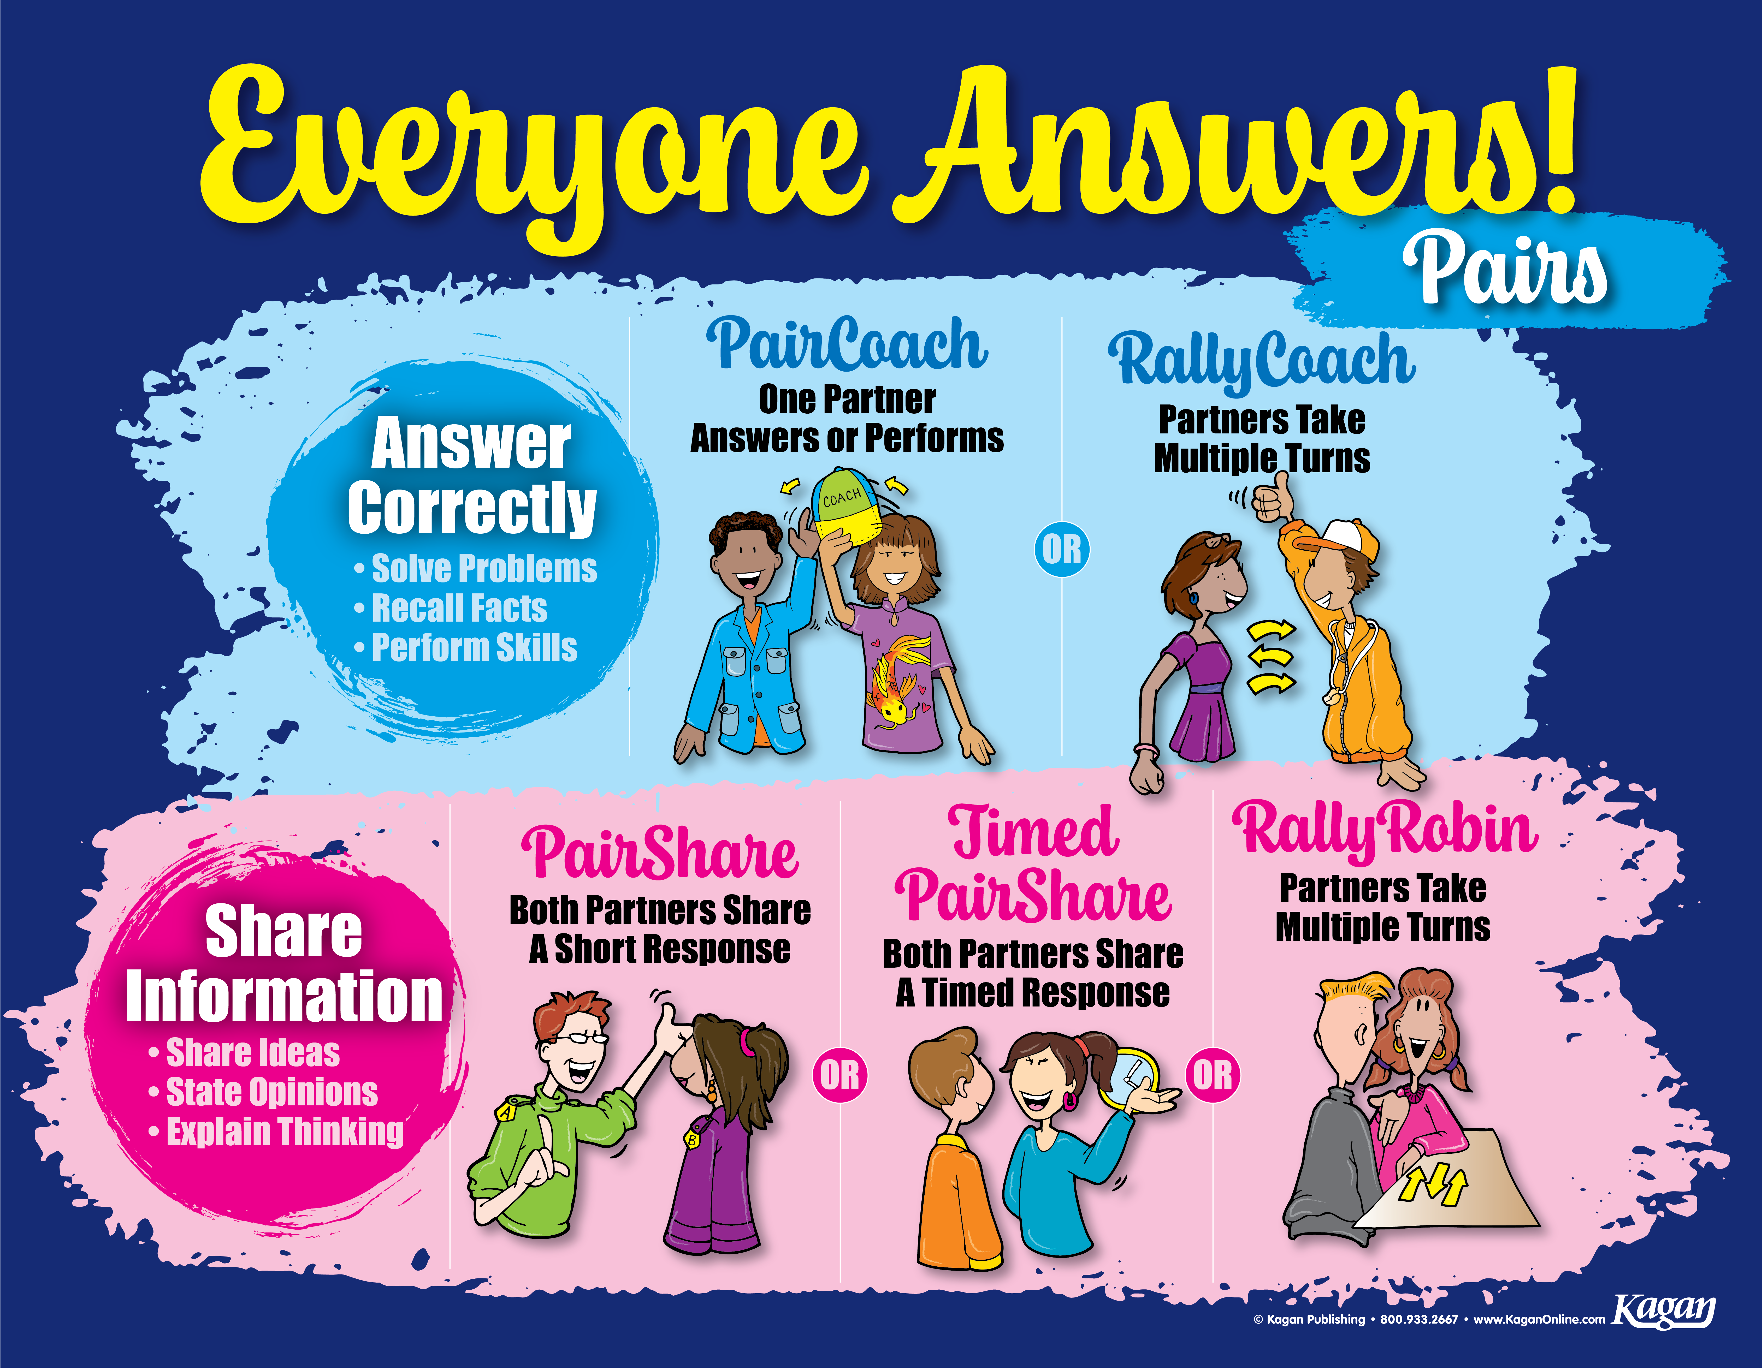
Priority 4 – Kagan Journey

Slide 14
Priority 5 – Safeguarding
Success Criteria | Actions
5.1 To ensure there is a culture at Juniper where we listen to the children and take account of their views and wishes | For the children to share their views on how safe they feel in school. To address any issues raised, (ask Juniper Cabinet to action). For the children to create a Child Friendly Safeguarding Policy.
5.2 To ensure there is a culture at Juniper where we listen to the children and take account of their views and wishes | For the children to share their views on the content of our Online Safety curriculum (possibly introduce a Cyber Squad?)
5.3 To address the safeguarding actions identified from recent training and from reading KCSIE2025 | Documented evidence of challenge from the governing body. Share regular safeguarding updates with the Juniper Team. Add safeguarding context to SEF. Deliver safeguarding assemblies, Ensure our most vulnerable children are taught a 'safeguarding curriculum’.

Slide 15
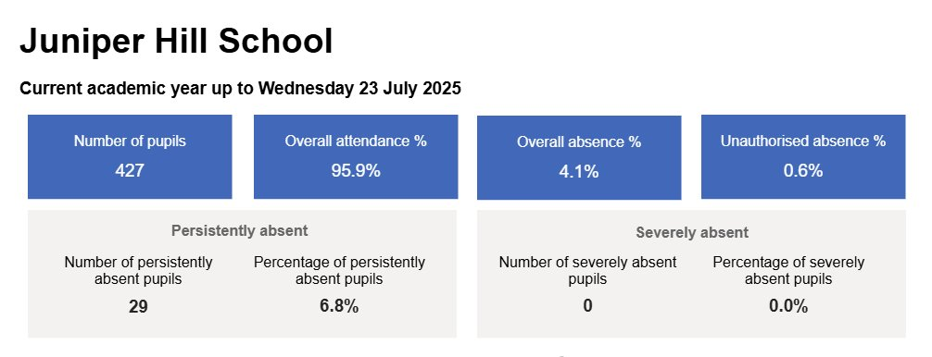
Attendance

Slide 16
What the research shows
Research consistently shows a strong link between consistent attendance and higher earning potential, with a 2025 GOV.UK report finding that each additional day of absence in secondary school can be associated with a loss of £750 in future earnings, and persistent absence linked to earning £10,000 less by age 28.

Slide 17


