Slide 1


Year 3
Meet the Teacher
Juniper Hill School
23rd September 2026

Slide 2
Working together
At the heart of Juniper are the strong, positive relationships we build between home and school. Relationships matter to us.
We value working in partnership with you, and we recognise that you know your children best.
To ensure a smooth and successful transition, we have met with the previous class teachers to discuss each child’s strengths, interests and individual needs.
We have also carefully read the transition questionnaires some of you completed which provide valuable insights into your children.
By working together and building strong relationships from the outset, we want to make sure your children have a successful year.

Slide 3
Meet the Team:
Waxwings teacher: Miss Brett
Miss Hunt to cover PPA on Tuesday morning until 11:30
Kestrels teacher: Miss Davenport
Mr Martin to cover PPA on Thursday morning until 11:30
Mr Collins to teach Waxwings Thursday morning 9:00-10:30 and Kestrels Monday mornings 10:45-11:45

Slide 4
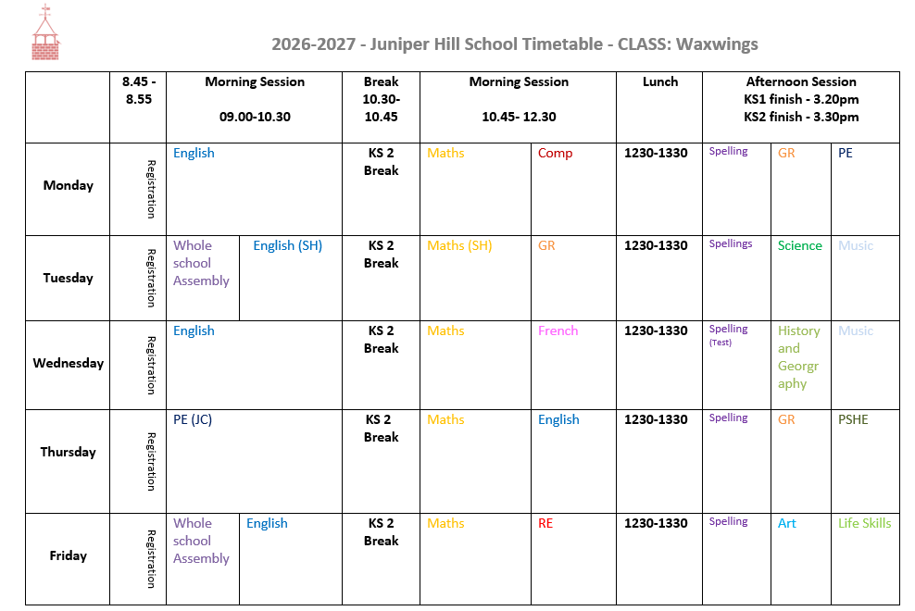
Our Timetable
02/10/2026

Slide 5
Curriculum Coverage
We teach the curriculum through engaging strategies such as Kagan Cooperative Learning and our "Be Like a“ approach, helping children develop confidence, resilience and teamwork. Lessons build knowledge and skills progressively, with regular opportunities to revisit and apply learning.
A key focus is developing secure foundational knowledge - the essential skills and understanding children need for future learning. Strong foundations help children make connections, retain knowledge and succeed across the curriculum.
Please visit the Curriculum Overviews and Curriculum pages on our school website to find out what your child will be learning and how you can support them at home.
Reading underpins all learning. Regular reading helps develop vocabulary, comprehension and confidence across every subject. Please encourage daily reading at home. Our year-group reading tips are on the next slide.
02/10/2026

Slide 6
Reading tip ideas
Reading with your child everyday is crucial and is a vital part of their learning.
In Year 3 children are encouraged to read with expression- Encourage your child to change their voice for different characters and punctuation. Model a sentence first, then ask them to copy your expression.
When reading with your child ask 'prove it’ questions. Move beyond 'what happened' and ask, 'How do you know? Encourage your child to find evidence.

Slide 7
Year Group Events
Swimming in Autumn term- Kestrels in Autumn 1 and Waxwings in Autumn 2. This is every Tuesday morning 9:00- 11:30.
16th November Gunnersbury Park Museum- Stone age survival day.
16th April Egyptian day- In house event.
We are in the process of arranging one more trip.
02/10/2026

Slide 8
Expectations
Now the children have moved up to KS2 the work/expectations of them has increased.
We have read the parental handover notes to aid the transition.
We set homework on a Friday it will be either maths or English. They will also do a weekly spelling and timetable test in school.
As a school we are no longer using the terminology ‘fidget toy’ but instead sensory tools.
02/10/2026

Slide 9
Assessment
The children will complete 3 lots of NFER papers this year (similar to previous years).
They will do 3 maths papers- Arithmetic and 2 reasoning papers. A reading paper. SPAG paper and a spelling paper.
This will be spread over a week.
The papers will be different from the least set the children did as they were SATs and gave a different score (scale score rather than standardised).
They will be done on the week commencing: 30th November, 8th March and 21st June.
02/10/2026

Slide 10
Admin
If your child requires any medication it must goes though the office and you will be required to fill out a form so we can administer it.
Children will be able to go home with adults listed on the collection form. If plans change please let us know and drop us an email.
02/10/2026

Slide 11
Questions
Any questions?
If you think of anything else we have an open door policy and we want to work with you and your child so feel free to talk to us or drop us an email.
02/10/2026

