Slide 1


Year 1
Meet the Teacher
Juniper Hill School
23rd September 2026

Slide 2
Working together
At the heart of Juniper are the strong, positive relationships we build between home and school. Relationships matter to us.
We value working in partnership with you, and we recognise that you know your children best.
To ensure a smooth and successful transition, we have met with the previous class teachers to discuss each child’s strengths, interests and individual needs.
We have also carefully read the transition questionnaires some of you completed which provide valuable insights into your children.
By working together and building strong relationships from the outset, we want to make sure your children have a successful year.

Slide 3
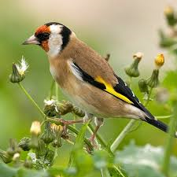
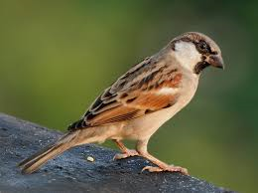
Meet the Team:
Goldfinches Sparrows
Mrs Brettenny (Miss But Thu until Oct halfterm) Miss Martin
Mrs Freshwater (am) Miss Reynolds (Mon-Wed am)
Mrs McDonald (pm) (Wed-Fri pm)
PPA – Tuesday pm
Mr Collins Ms Harris
PE Forest School/Singing

Slide 4

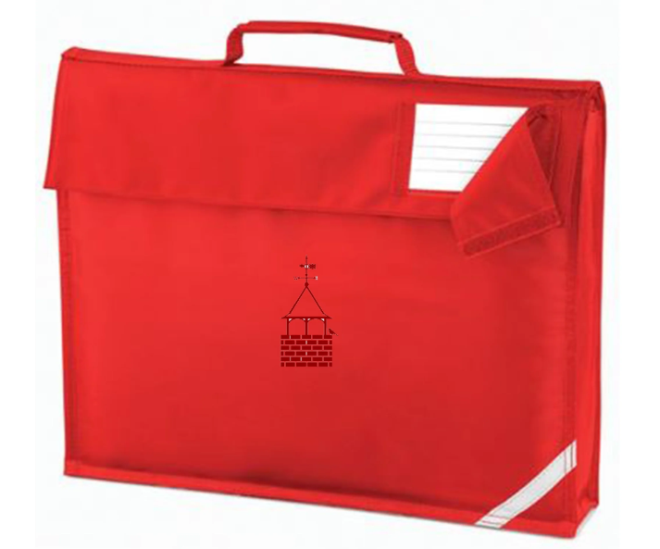

Reading tip ideas
Year 1 Routines
Book bag, reading record and book, water bottle and snack box in school everyday.
Every Friday on our book changing day please have reading books ready to hand in.
Big bags and pencil cases are not required.
Yr 1 Practise sounding out and blending. Ask your child to point to each grapheme, say the sounds and blend them together. Keep practising the words they find tricky rather than guessing from pictures. Set aside time to practise the story green, speedy green and red words found inside the book.
Read the same book more than once. Repeated reading helps children become more fluent and confident. Talk about the pictures and ask simple questions such as What happened and How do you know? R1- for decoding, R2- building fluency and R3 for comprehension.

Slide 5
PE Timetable
Goldfinches & Sparrows – Tuesday Autum 1/Spring 1(Forest School)
- Monday & Tuesday other terms
Name Labels on everything.
Please encourage your children to practice getting changed themselves at home and turn their clothes in the right way.
Please make sure children have got a warm PE kit in school.

Slide 6

Curriculum Coverage
We initially follow a Reception style approach to learning to enable the children to make a smooth transition into Year 1.
Maths and English activities are done in small groups in the mornings.
In the afternoons other stand-alone subjects, i.e. PE, RE, Music, Computing, Jigsaw, Science, History, Geography and Life Skills are timetabled.
We use Kagan structures encouraging children to engage with partners and group work, not just ‘calling on one’.
Our Curriculum has a real focus on FOUNDATIONAL KNOWLEDGE – the very basics that a Year 1 child should have that allows us to build on.
Curriculum overviews and the curriculum pages on the website

Slide 7

Reading and homework
Phonics will be taught 5 times a week in groups.
Please encourage your child to read school books three times as per the letter previously sent home.
Please record that the book has been read three times.
BOOK CHANGING IS EVERY FRIDAY.
Reading other material at home is also very valuable – including the online books set weekly.
Homework and spellings will start after half term.

Slide 8
Assessment
Year 1 complete assessments in Spring 2 and Summer 2 – results will be sent home to parents.
Ongoing assessment in class – Foundational Knowledge
Phonics Assessment – Week of 14th June 2027

Slide 9
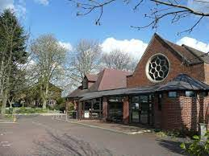

Trips
Walk to Christchurch in Autumn 2/Spring 1.
Oxford Science Centre in Summer 1.

Slide 10

Communication
For a quick chat we are happy to take messages in the morning.
For longer conversations, we are happy to chat with you after school.
We will pass on messages via the class rep.
Any health care plans/medicine needs to go via the office please.
Daily medicines to also go via the office with a signed permission form.
Please update teachers on any medication that you may have administered that morning so that we can update our records accordingly.
Change of pick up arrangements – please email the office or let the class teacher know that morning.
Birthdays - No sweet treats please. Children’s birthdays will be celebrated within the classroom with a song and each child will be given a Class Birthday Card.

Slide 11

Questions
Time for questions

