Slide 1


Year 1 Phonics
Screening Check

Slide 2
What is the Phonics Screening Test?
Children in Year 1 throughout the country will be taking part in a
phonics screening test during the same week in June.
Children in Year 2 will also take the test if they did not achieve the
required result when in Year 1, or if they have not taken the test
before.
The phonics screening check is designed to confirm whether
individual children have learnt sufficient phonic decoding and
blending skills to an appropriate standard. To check the children
have a firm foundation on which to become confident and fluent
readers.

Slide 3


WHAT WILL IT CHECK?
It will check that your child can:
Sound out and blend graphemes (letters or groups of letters) in order to read words.
Read phonically decodable words.
Read a selection of nonsense words which we
Call ‘Alien words’.

Slide 4
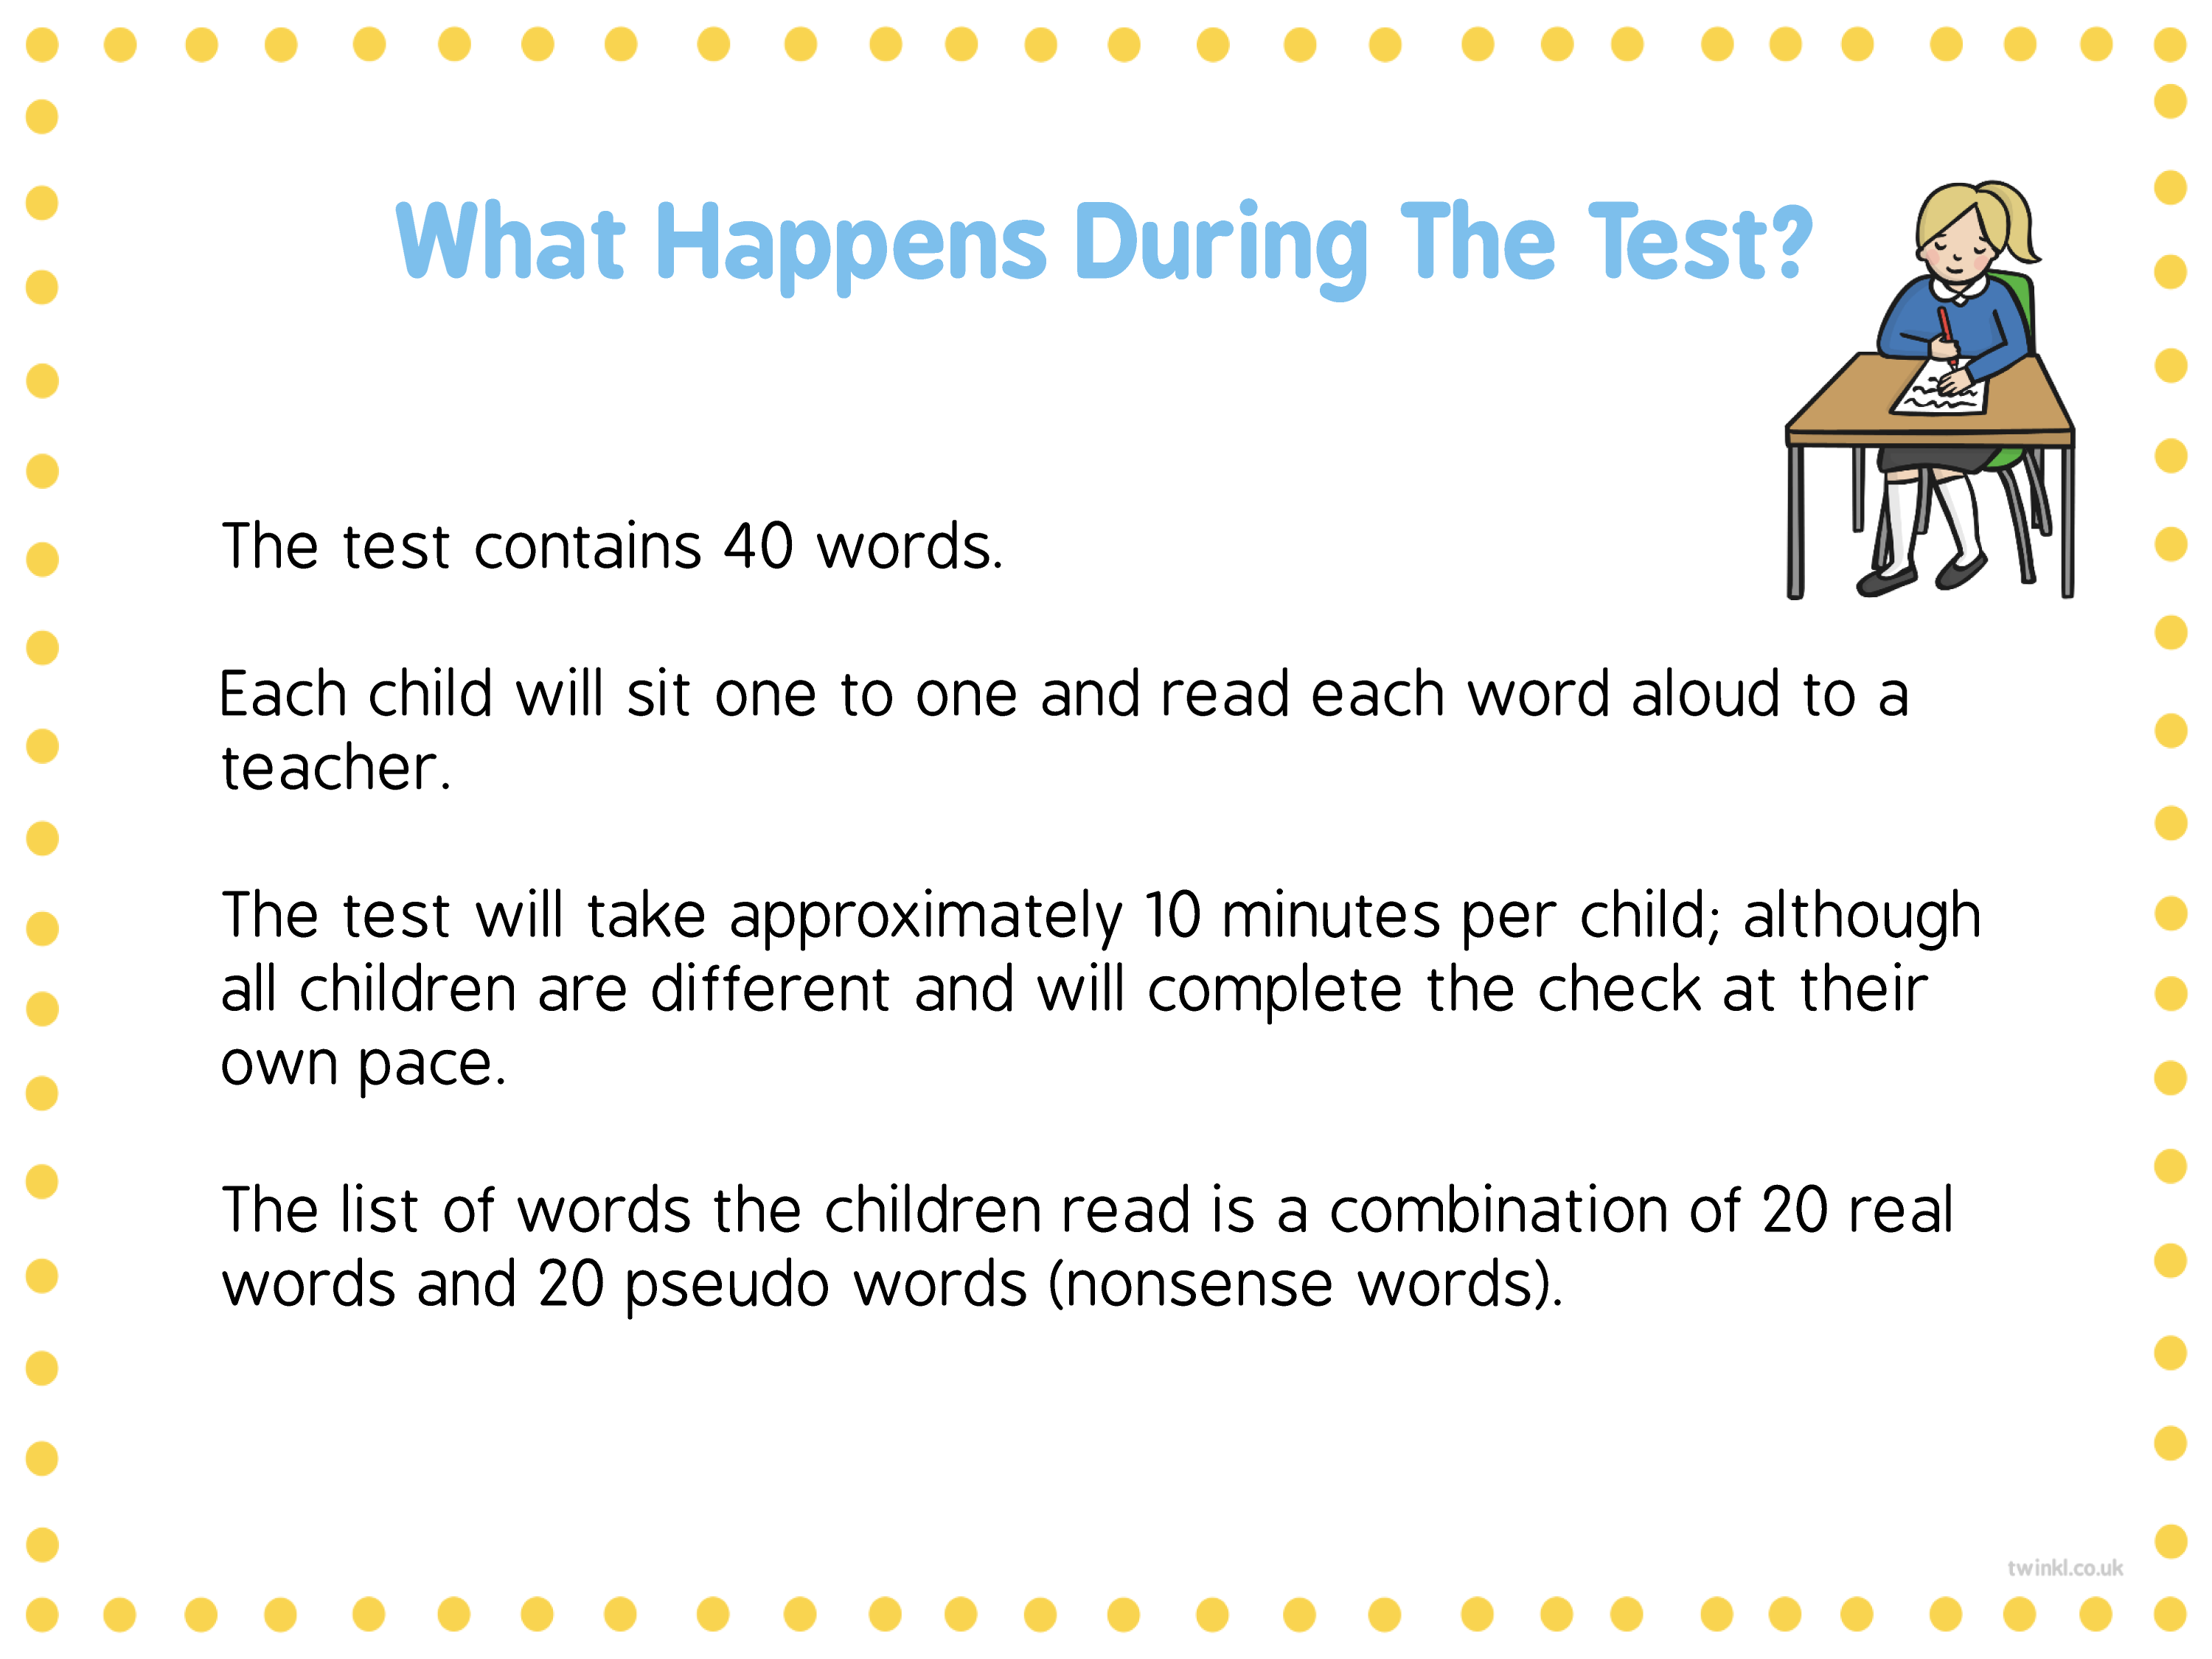
WHAT IS THE YEAR 1 PHONICS SCREENING CHECK?
The phonics screening check will be taken individually by all children in Year 1 in England – this began in June 2012. It is designed to give teachers and parents information on how your child is progressing in phonics. It will help to identify whether your child needs additional support at this stage so that they do not fall behind in this vital early reading skill.

Slide 5
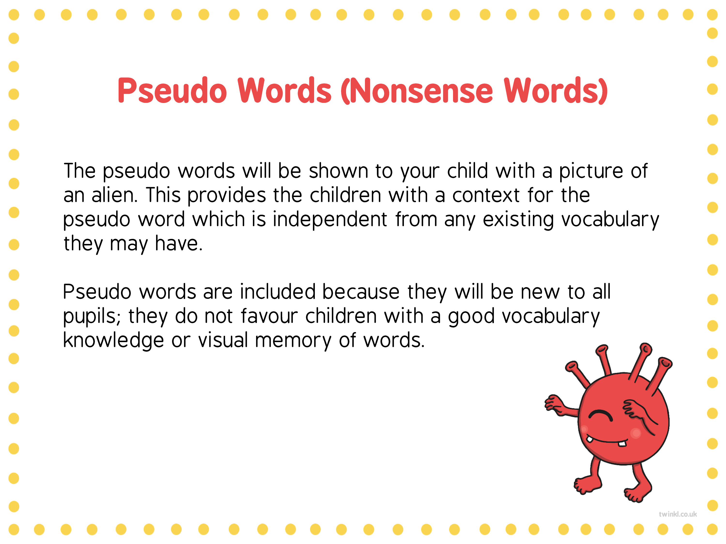


Slide 6

Alien words are included in the check specifically
to assess whether your child can decode a word
using their phonics skills and not their memory.
“Special friends - Fred Talk - Read the word”
The check does not measure reading fluency.

Slide 7
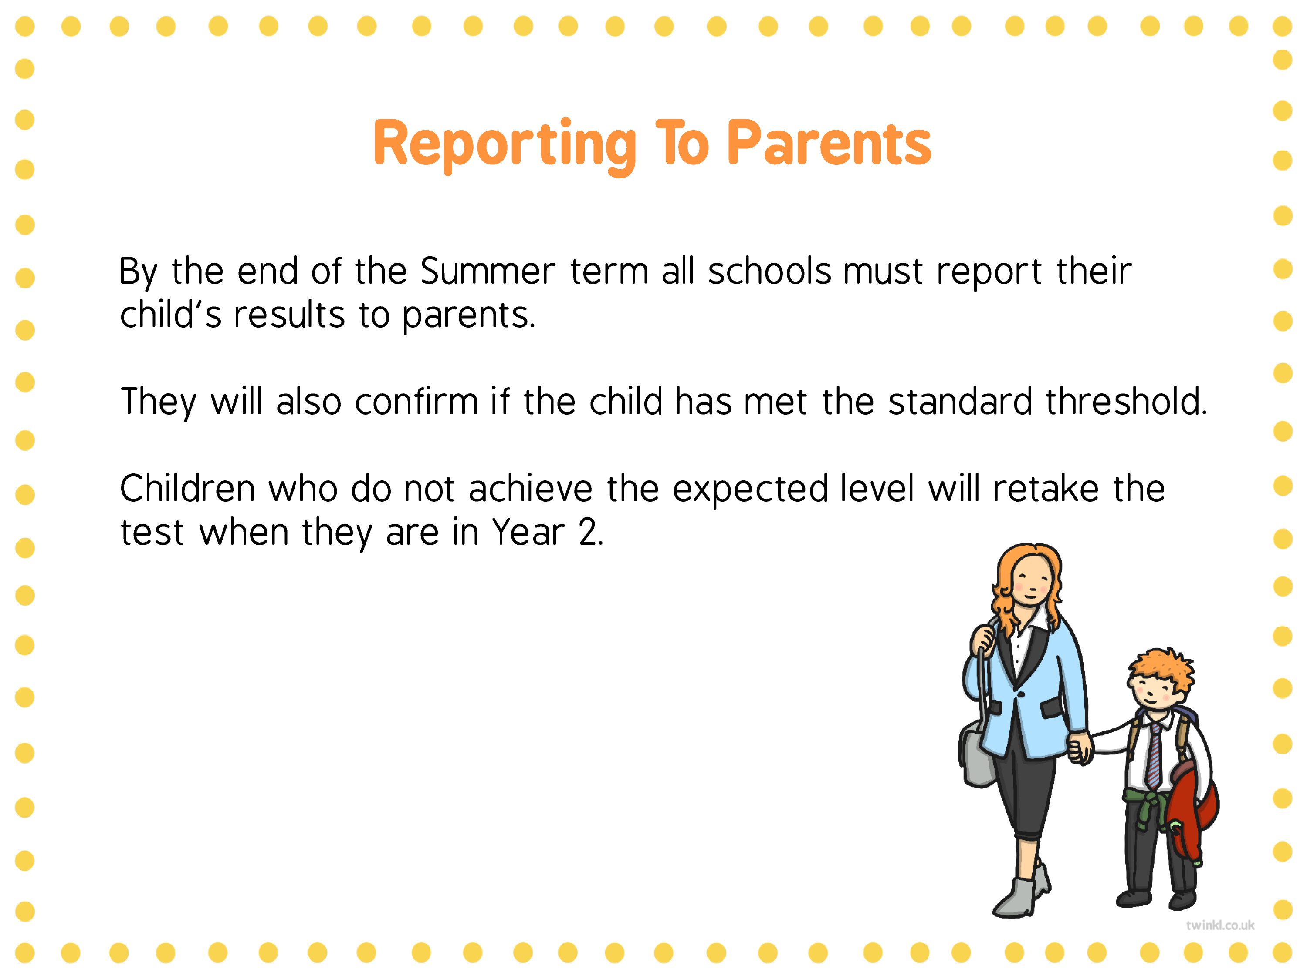
Historically the pass mark has been around 32 out of 40.

Slide 8
WHEN WILL THE
SCREENING TAKE PLACE?
The screening will take place throughout the week beginning Monday 6th June. All children will complete the screening check during this week.
Any child who is absent from this time up until the 17th June will be recorded as absent in the results data.

Slide 9
HOW CAN YOU HELP ?
You can try using:
Phonics screening past papers – available to download for free online via google
Use www.phonicsplay.co.uk - Click Phase 5 - revise all words when playing these online games.
- ‘BURIED TREASURE’ - https://www.phonicsplay.co.uk/resources/phase/2/buried-treasure
- ‘Dragons Eggs’- https://www.phonicsplay.co.uk/resources/phase/2/dragons-den
Use the phonic packs we will send home from next week.
Continue reading as much as possible.

Slide 10
QUESTIONS?

